Slide 1


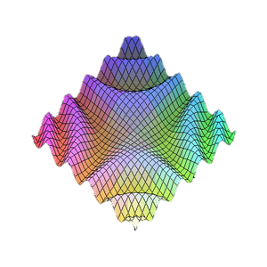

JavaScript Patterns
Modules and stuff
JavaScript OOP
Telerik Software Academy
http://academy.telerik.com

Slide 2

Table of Contents
Public/Private fields in JavaScript
Module pattern
Revealing module pattern
Singleton pattern

Slide 3
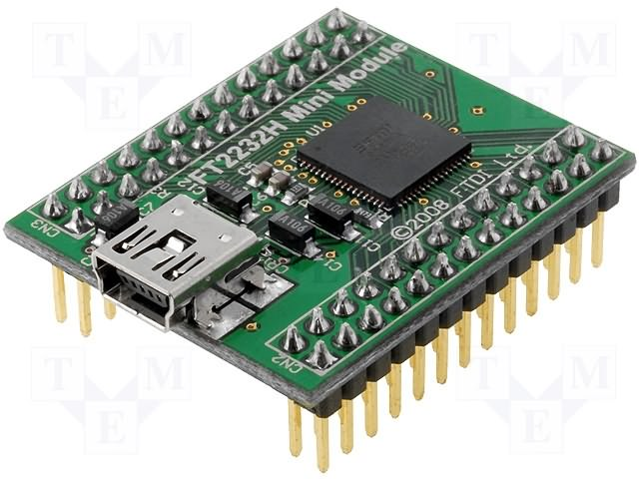
The Module Pattern
Hide members

Slide 4
Pros and Cons
Pros:
“Modularize” code into re-useable objects
Variables/functions not in global namespace
Expose only public members
Cons:
Not easy to extend
Some complain about debugging

Slide 5
Module Pattern: Structure
Structure:
var module = (function() {
//private variables
//private functions
return {
//public members
someFunc: function() {…},
anotherFunc: function() {…}
};
}());

Slide 6
Module Pattern: Example
Example:
var controls = (function () {
function formatResult(name, value) {
return name + ' says the result is ' + value;
}
var calculator = {
init: function (name) { /* init code */ },
add: function (x) { /* code to add */ },
subtract: function (x) { /* code to subtract */ },
showResult: function () { /* code to show result */ }
};
return {
getCalculator: function (name) {
return Object.create(calculator)
.init(name);
}
};
} ());
controls.getCalculator('First')
.add(7) .showResult() .subtract(2) .showResult();

Slide 7
Module Pattern: Example
Example:
var controls = (function () {
function formatResult(name, value) {
return name + ' says the result is ' + value;
}
var calculator = {
init: function (name) { /* init code */ },
add: function (x) { /* code to add */ },
subtract: function (x) { /* code to subtract */ },
showResult: function () { /* code to show result */ }
};
return {
getCalculator: function (name) {
return Object.create(calculator)
.init(name);
}
};
} ());
controls.getCalculator('First')
.add(7) .showResult() .subtract(2) .showResult();
The visible members create closures with them

Slide 8
Module Pattern: Example
Example:
var controls = (function () {
function formatResult(name, value) {
return name + ' says the result is ' + value;
}
var calculator = {
init: function (name) { /* init code */ },
add: function (x) { /* code to add */ },
subtract: function (x) { /* code to subtract */ },
showResult: function () { /* code to show result */ }
};
return {
getCalculator: function (name) {
return Object.create(calculator)
.init(name);
}
};
} ());
controls.getCalculator('First')
.add(7) .showResult() .subtract(2) .showResult();
Visiable method

Slide 9
Module Pattern: Summary
Module pattern provides encapsulation of variables and functions
Provides a way to add visibility (public versus private) to members
Each object instance creates new copies of functions in memory

Slide 10

Module Pattern
Live Demo

Slide 11

The Revealing Module Pattern
Reveal the most interesting
members

Slide 12
Revealing Module Pattern: Pros and Cons
Pros:
“Modularize” code into re-useable objects
Variables/functions taken out of global namespace
Expose only visible members
"Cleaner" way to expose members
Easy to change members privacy
Cons:
Not easy to extend
Some complain about debugging
Hard to mock hidden objects for testing

Slide 13
Revealing Module Pattern: Structure
Structure:
var module = (function() {
//hidden variables
//hidden functions
return {
//visible members
someFunc: referenceToFunction
anotherFunc: referenceToOtherFunction
};
}());

Slide 14
Revealing Module Pattern: Example
Example:
var controls = (function () {
function formatResult(name, value) {
return name + ' says the result is ' + value;
}
var calculator = {
init: function (name) { /* init code */ },
add: function (x) { /* code to add */ },
subtract: function (x) { /* code to subtract */ },
showResult: function () { /* code to show result */ }
};
function getCalculator(name){
return Object.create(calculator).init(name);
}
return { getCalculator: getCalculator };
} ());
controls.getCalculator('First')
.add(7) .showResult() .subtract(2) .showResult();

Slide 15
Revealing Module Pattern: Example
Example:
var controls = (function () {
function formatResult(name, value) {
return name + ' says the result is ' + value;
}
var calculator = {
init: function (name) { /* init code */ },
add: function (x) { /* code to add */ },
subtract: function (x) { /* code to subtract */ },
showResult: function () { /* code to show result */ }
};
function getCalculator(name){
return Object.create(calculator).init(name);
}
return { getCalculator: getCalculator };
} ());
controls.getCalculator('First')
.add(7) .showResult() .subtract(2) .showResult();
Create the function hidden

Slide 16
Revealing Module Pattern: Example
Example:
var controls = (function () {
function formatResult(name, value) {
return name + ' says the result is ' + value;
}
var calculator = {
init: function (name) { /* init code */ },
add: function (x) { /* code to add */ },
subtract: function (x) { /* code to subtract */ },
showResult: function () { /* code to show result */ }
};
function getCalculator(name){
return Object.create(calculator).init(name);
}
return { getCalculator: getCalculator };
} ());
controls.getCalculator('First')
.add(7) .showResult() .subtract(2) .showResult();
Expose (reveal) only references to hidden member

Slide 17
Revealing Module Pattern: Summary
Module pattern provides encapsulation of variables and functions
Provides a way to add visibility (public versus private) to members
Extending objects can be difficult since no prototyping is used

Slide 18
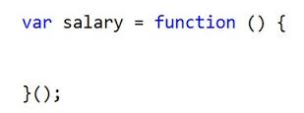
Revealing Module Pattern
Live Demo

Slide 19

Singleton Pattern
One object to rule them all!

Slide 20
Singleton Pattern: Structure
Singleton pattern introduces a single instance each time an instance is requested
Harder in other languages, in JavaScript every IIFEs forms a singleton
Structure:
var module = function() {
var instance = { /* code for instance */};
instance = Object.preventExtensions(instance);
return {
get: function(){
return instance;
}
};
}();

Slide 21
Singleton Pattern: Example
Example:
var calculator = (function () {
var calculator = {
result: 0,
add: function (x) { /* code for add */ },
subtract: function (x) { /* code for subtract */ },
showResult: function () { /* show result */ }
};
calculator = Object.preventExtensions(calculator);
return { get: function () { return calculator; } };
} ());
calculator.get() .add(7) .subtract(17) .showResult();
//result is -10
calculator.get() .add(111) .showResult();
//result is 101 (continues from the previous)

Slide 22

Singleton Pattern
Live Demo

Slide 23
Augmenting Modules
Augmenting modules means "Split modules in many files/IIFEs:
Can be used like a module/revealing module pattern, but with a small fix:
module-1.js
var module = module || {}; // if module exists
(function(scope){
scope.obj1 = { /* core for obj1 */ };
}(module));
module-2.js
var module = module || {}; // if module exists
(function(scope){
scope.obj2 = { /* core for obj2 */ };
}(module));

Slide 24
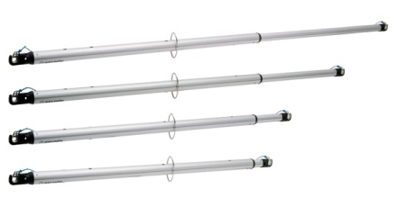
Augmenting Modules
Live Demo

Slide 25

Modules and Patterns
http://academy.telerik.com

Slide 26




Free Trainings @ Telerik Academy
“C# Programming @ Telerik Academy
csharpfundamentals.telerik.com
Telerik Software Academy
academy.telerik.com
Telerik Academy @ Facebook
facebook.com/TelerikAcademy
Telerik Software Academy Forums
forums.academy.telerik.com

